Slide 1
Nabeel Hyatt
“Some of the best founders I’ve worked with
tend to start by writing a free-form note from the CEO. Almost a journal entry giving their honest, often emotional assessment of what it is like on the ground of the company at this moment. Long form writing gives you the opportunity to gather your thoughts, and portray things that will never come through in bullet points and charts.
Board Meeting
Q1 2025
Your company name
April 27, 2025

Slide 2
Agenda
Nabeel Hyatt
“Don’t get stuck updating the board on the past for 3 hours. Reporting on the past should be brief, just for context to those not there day-to-day, and to help codify any new learnings from what just happened. I have always loved one founders’ description of a board meeting as a mini-offsite for the executive team, with guests.
15
minutes
CEO Overview
Financials, OKRs, and KPIs
15
minutes
Team
Departmental Team Updates
30
minutes
Proposed New OKRs
Product Roadmap
60
minutes
Strategy
Board Approvals

Slide 3
CEO Overview
10 minutes
Nabeel Hyatt
“CEOs often skew super positive or super negative - a structure like this helps founders to give space to balance both.”
What Keeps Me Up at Night
Existential Threats
Looming Mistakes
What’s Going Better Than Expected
Delivered or beat on strategic goal
Continuous process improving
What we want out of today
Are we moving too fast or too slow?
Too aggressive or conservative?
Preview any potential strategy discussions

Slide 4
Q1 2025 Cash and Burn
2 minutes
Nabeel Hyatt
“Keep this basic early in a companies life: cash in bank, monthly burn, runway.”
CASH IN BANK
NET BURN
RUNWAY
$5,100,742
-$68K (Mar)
28 months
As of 3/31/2025
-$243K (Jan)
-$232K (Feb)
Mar 2025
MONTHLY BALANCE
$6M
$5.9M
$5.6M
$5.4M
$3.6M
$4M
$5.2M
$3M
$0M
Oct 2024
Nov 2024
Dec 2024
Jan 2025
Feb 2025
Mar 2025

Slide 5
Q1 2025 Past OKRs
10 minutes
Nabeel Hyatt
“Goals in startups should not be all green or you are likely not taking enough risk. Public companies have to hit every number projected, which can lead to incrementalism. But a startup is a learning experience where you don’t know what could 10x your company. Pick some OKRs that are “must hits,” and some that are moonshots. Make sure the team knows the difference!”
Q1 Goal | Key Results | Status | Notes
Product Objective 1 | Established roadmap goal by certain time KPI related to objective declined | Bad | Result High level learnings Adjustment moving forward
Product Objective 2 | Develop benchmarks for performance & engagement for new feature New feature drives improvement in KPI | Good | “ “
Sales Objective 1 | Grow/shrink sales team to certain size Deliver +/- X% of quarterly sales goal | Ok | Stretch OKR. Tried new direct sales strategy, didn’t work.
Marketing Objective 1 | Content has # views and differentiated voice Brand awareness hits milestone | Ok | “ “

Slide 6
Q1 2025 Actuals vs. Plan
4 minutes
Nabeel Hyatt
“When addressing actuals vs plan, big surprises (good and bad) should be pointed out very clearly and discussed. More than meet or beat, I want to know what you learned. I’m a big fan of color coding throughout a deck to signal quickly to the board what you think is worth attention.”
 | Q1 2025 Actual | Q1 2025 Plan | Variance | Note
Revenue | 150,000.00 | 180,000.00 | 17% | Reason for miss/beat
Gross Margin (%) | 65% | 60% | 5% | “ “
Operating Expenses | 300,000 | 310,000 | -3% | “ “
Net Income | -202,500 | -202,000 | 0% | “ “

Slide 7
2024 Forecast vs. Plan
4 minutes
Nabeel Hyatt
“When backing up to a yearly view, this should inevitably lead to a conversation of whether you are on track for the next fundraise.”
 | 2024 Forecast | 2024 Plan | Variance | Note
Revenue | 780,000.00 | 850,000.00 | -8% | Forecast varies from plan because…..
Gross Margin (%) | 70% | 60% | 10% | Margin improved as a result of ….
Operating Expenses | 1,500,000 | 1,900,000 | -21%
Net Income | -954,00 | -1,390,000 | -31%
Headcount | 32 | 38 | -16%

Slide 8
KPIs
2 minutes
Nabeel Hyatt
“KPIs are the vital signs of the business, the 5-20 metrics that give a glanceable view of the business from a bunch of angles. KPI dashboards generally do not have goals tied to them, just what is “healthy” and not healthy. If a KPI becomes critical enough that the team needs to focus on moving it, it becomes an OKR.”
 |  | Jan-25 | Feb-25 | Mar-25 | % Change QoQ | % Change YoY | % Change YTD
Registrations / Week (000s) |  | 2,500 | 2,900 | 3,800 | 100% | 300% | 100%
Monthly Active Users (000s) |  | 175 | 340 | 660 | 400% | 700% | 400%
Daily Active Users ('000s) |  | 16 | 21 | 24 | 120% | 500% | 120%
Week 1 Retention |  | 21% | 24% | 23% | 2% | 4% | 2%
Referrals: K Rate |  | 0.20 | 0.28 | 0.35 | 130% | 220% | 130%
Net Bookings / Month |  | $2,350,000 | $2,750,000 | $3,430,000 | 90% | 350% | 90%
Subscription MRR |  | $2,100,000 | $2,450,000 | $3,200,000 | 100% | 400% | -100%
Customer Acquisition Cost |  | $0.23 | $0.14 | $0.10 | -60% | -80% | -60%

Slide 9
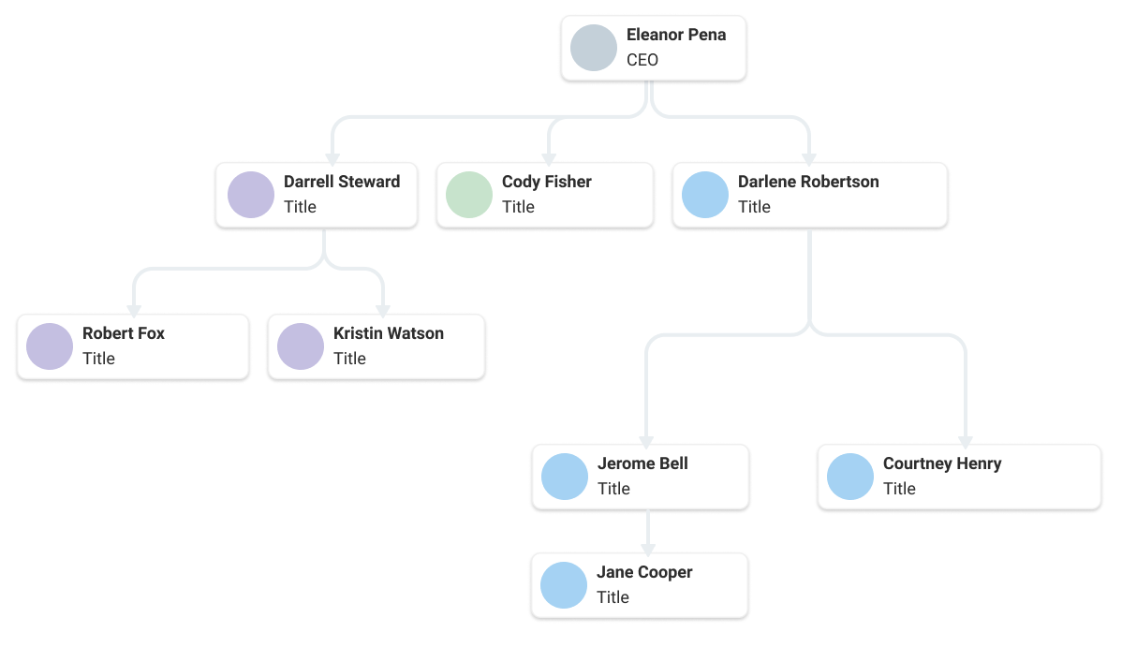
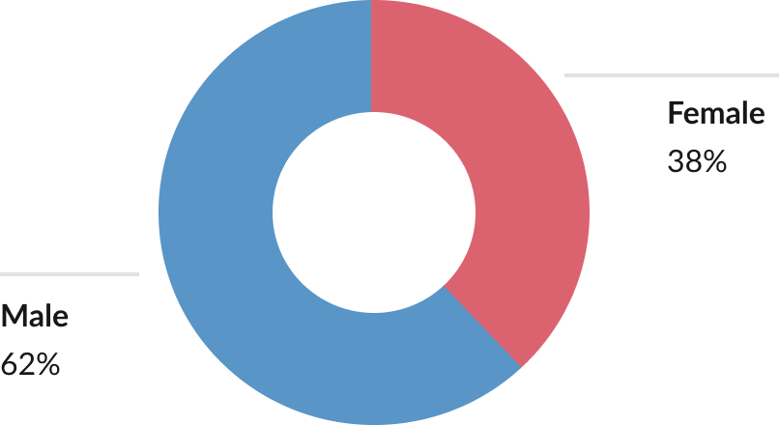
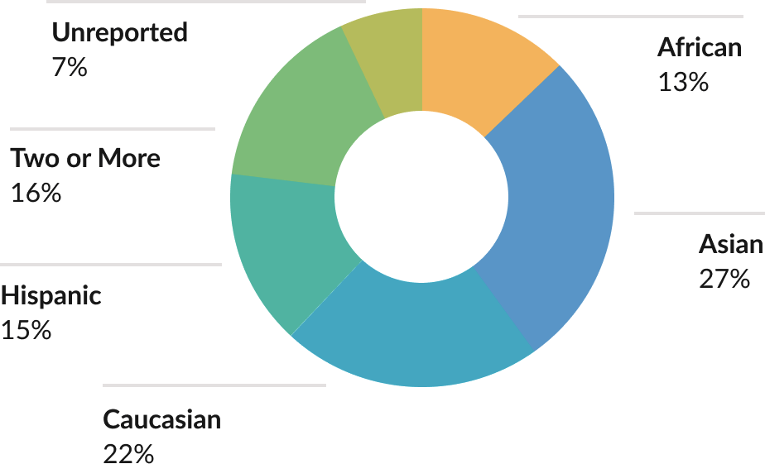
Team
10 minutes
Nabeel Hyatt
“Don’t be afraid to ask for help with recruiting. Founders seem to value the qualitative discussion of candidates and team dynamics matters just as much as the quantitative. ”
Current Team headcount
Org chart
Hiring plan and recruiting needs
Where we need the most help

Slide 10
Department Updates: Sales & Marketing
15 minutes
Nabeel Hyatt
“Make sure the team is in the habit of tying their individual goals directly back to a company OKR and the company’s mission. You can hit a Key Result while failing the actual Objective.”
Sales
Pipeline; customers added and total
Topline goals and scale metric (ex: GMV/ARR)
Team growth/scaling strategy
Marketing
Outbound vs. inbound lead strategy
Messaging and campaigns; define target audience
Content/awareness goals and quantifiable metrics
 | Q1 2025A | Q1 2025E
SQLs | 100 | 120
New Customers | 20 | 30
Existing Customers | 100 | 110
New Business | $40,000 | $50,000
GMV/ARR | $500,000 | $510,000
 | Q1 2025A | Q1 2025E
Paid Acquisition ($) | $30,000 | $25,000
Website Visits | 1,800 | 2,000
Email Sign Ups | 800 | 500
MQLs | 200 | 150
Notes:
Combine S&M

Slide 11
Proposed Next Quarter OKRs
15 minutes
Nabeel Hyatt
“If you’ve set up the rest the board deck right, everyone including your team should have the context to really talk through these goals & which should be stretch goals and which should be easy. Timescale this conversation by what needs to get done in the upcoming quarter, and before the next large milestone.”
Proposed Goals | Potential Key Results (TBD) | Probability
Develop feature for Product X to Improve KPI Y | Establish roadmap goals by certain date Hit goals by certain date | 100%
Push Advantage with Product Z | Map out product Z 2.0 by certain date Beta test with # of select users | 75%
Q2 Sales Objective | Grow/shrink sales team to certain size Deliver +/- X% of quarterly sales goal | 50%
Q2 Marketing Objective | Reach X number of potential customers Differentiate brand via X key metric | 50%
Goals by next fundraise (Q4 2025) | Status
Revenue 3x y/y,$xxx | Bad
LTV/CAC over 3x in first 90 days | Good
3 marquee customers with ATV over $1m ea. | Ok
Working demo of v2 video product | Ok

Slide 12
Product Roadmap
15 minutes
Nabeel Hyatt
“The roadmap challenge is keeping it high enough level to be readable, but not so high level that none of it is controversial. Get out of the abstract, include screenshots or mockups. The Risk and Impact columns can help a team & board calibrate if they have enough moonshots vs incremental features.”
 | Product Area | Features | Risk | Impact - Notes
By Next Quarter | Product 1 to be expanded by end of Q2 | Feature 1 being added to product 1 | Low | High - Big dependency for OKR1
 | Product 2 to be expanded by end of Q2 | Feature 1 being added to product 2 | Low | Low - #1 requested quality of life for users
 | Product 3 to be expanded by end of Q2 | Feature 1 being added to product 3 | High - Moonshot | High - Would transform demand-side acquisition
By End of Year | Product 1 to be expanded by end of 2025 | Feature 1 Feature 2
By Next Fundraise | Product 1 to be expanded by next fundraise | Feature 3 being added to product 1

Slide 13
Open Strategy Questions
45 minutes
Nabeel Hyatt
“If you’ve kept pace, then everything in the deck up until now can take just an hour and is just the context to really dig into these strategic questions. Don’t be afraid to spend 3/4 of the meeting on this section during key moments in a company's journey. Ultimately, this is what your board is here for.”
Highest Priority Issues
Broad issues to work through
Product directions and pivots (if this, then that)
Opportunistic alliances/bd/acquisitions
Worries and areas where the board can help

Slide 14
Option Grants
5 minutes
Nabeel Hyatt
“Founders should have approved bands of equity/salary by position so they can move quickly on hiring. Then time can be dedicated to the couple of folks that are out of the normal range. “
Proposed Option Grant
Employee | Start Date | Option Grant | % of Pool | % Fully Diluted | Position
Employee 1 | 2/1/2025 | 200,000 | 1% | 0.20% | Engineer
Employee 2 | 1/1/2025 | 500,000 | 3% | 0.50% | Dir Engineering
Employee 3 | 1/1/2025 | 500,000 | 3% | 0.50% | Dir PR
Option Pool Data
 | Shares | % Gross | % Fully Diluted
Total Pool Size | 20,000,000 | 100.00% | 20.00%
Options Previously Issued | 10,000,000 | 50.00% | 10.00%
Options Proposed Today | 1,200,000 | 6.00% | 1.20%
Remaining Unissued | 8,800,000 | 50.00% | 10.00%

Slide 15
Appendix

Slide 16
KPIs - Original
2 minutes
Nabeel Hyatt
“KPIs are the vital signs of the business, the 5-20 metrics that give a glanceable view of the business from a bunch of angles. KPI dashboards generally do not have goals tied to them, just what is “healthy” and not healthy. If a KPI becomes critical enough that the team needs to focus on moving it, it becomes an OKR.”
 |  | Actual | Actual | Actual | Forecast | Forecast | Forecast
 |  | Jan-25 | Feb-25 | Mar-25 | Apr-25 | May-25 | Jun-25
Monthly Active Users (000s)
Actual (Total) |  | 175 | 290 | 700
Forecast |  | 100 | 300 | 600 | 550 | 700 | 900
+ / - |  | 75 | -10 | 100
Daily Active Users ('000s)
Actual (average) |  | 16 | 21 | 24
Forecast |  | 14 | 17 | 26 | 26 | 28 | 34
+ / - |  | 2 | 4 | -2
Customer Acquisition Cost
Actual |  | $0.23 | $0.14 | $0.10
Forecast |  | $0.20 | $0.18 | $0.15 | $0.15 | $0.15 | $0.15
+ / - |  | $0.03 | -$0.04 | -$0.05
% Partner, Organic, Viral |  | 10% | 8% | 9% | 6% | 5% | 5%
Referrals: K Rate
Actual |  | 0.20 | 0.28 | 0.35
Forecast |  | 0.40 | 0.45 | 0.50 | 0.55 | 0.6 | 0.65
+ / - |  | -0.20 | -0.17 | -0.15

Slide 17
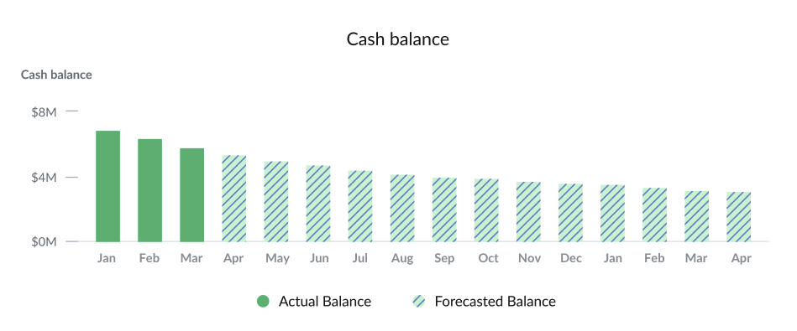
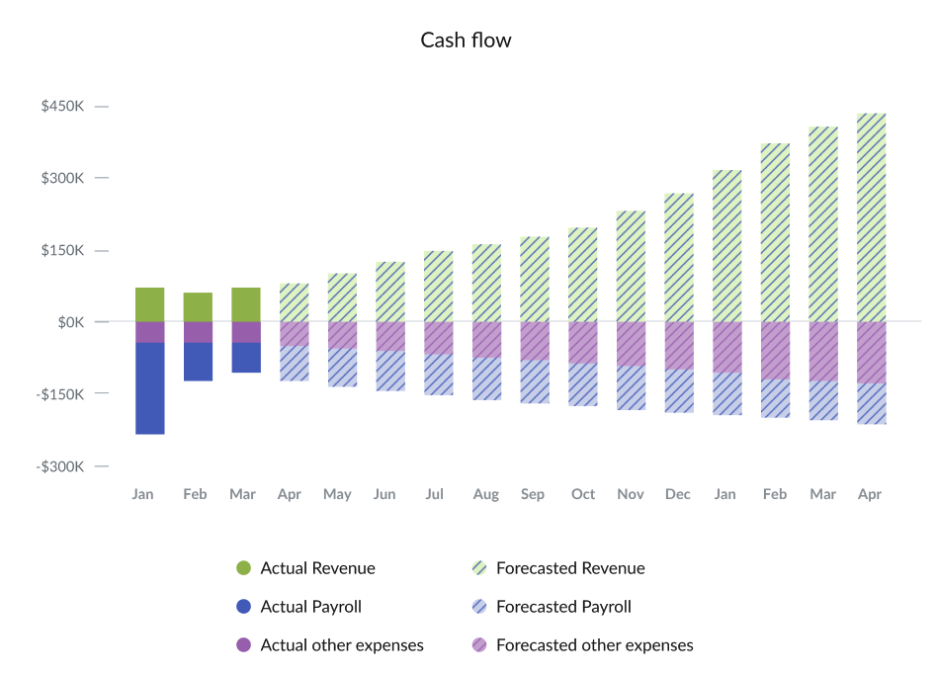
2025-2026 Forecast
2 minutes
Nabeel Hyatt
“ ”
As of ____, cash in bank is $___. Over the next ___ months (April 2025 - April 2026) net burn will go from ___ to ___ with an increase of ___%. Revenue from August 2025 to August 2026 will increase from ___ to ___, with a growth rate of ___.

Slide 18
Departmental Review
1 minute
Nabeel Hyatt
“For early companies, this is mostly product. As you scale, selectively include departments as it pertains to the problems you are facing. Once you mature, include all departments.”
Product
Sales & Marketing

Slide 19
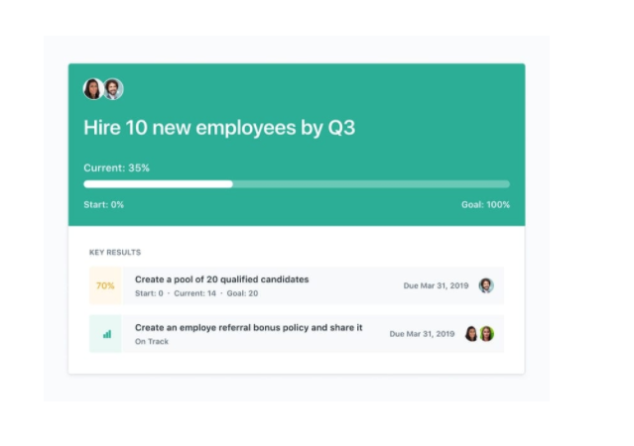
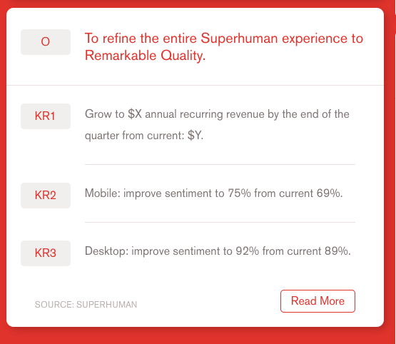
Department update: Product
7.5 minutes
Nabeel Hyatt
“For early companies, this is mostly product. As you scale, selectively include departments as it pertains to the problems you are facing. Once you mature, include all departments.”
Q1 Product Objective 1
Established 5 roadmap goals by certain dates - ✅
Didn’t hit goal by end of quarter - 🆇
KPI related to objective declined - 🆇
Deep dive on learnings from OKRs
Discuss planned adjustments moving forward
Q1 Product Objective 2
Develop benchmarks for performance & engagement - ✅
Meet or beat benchmarks - ✅
New feature improves KPI - ✅
Deep dive on learnings from OKRs
Discuss planned adjustments moving forward

