Slide 1
Board Meeting
Q1 2025
Joe Lonsdale
“Founders who keep their investors informed and run disciplined meetings are those who get the most out of their board members.
Too many board meetings waste time getting investors up to speed on the metrics, rather than strategic conversations getting their input and advice.”
Your company name
April 27, 2025

Slide 2
Disclaimer
The following template is general guidance and not prescriptive instructions. Depending on your sector and stage it may or may not be right for your company. While specifics might vary, the high-level takeaways are widely applicable and worth noting.

Slide 3
Table of Contents/Agenda
Joe Lonsdale
“The 1 hour time frame is most effective in the early stage. As your company matures, expect to feature more members of your executive team and be prepared to handle different expectations from new investors, yet continue to strive for brevity where possible and applicable."
2
minutes
Highlights and Lowlights
8
minutes
Metrics
Financial: Q1 2025, 2025-2026 forecasts
Product: Q1 2025 engagement metrics (NPS, Retention, MAU’s)
10
minutes
Goals and Milestones
Product roadmap, Sales pipeline, Marketing pipeline
35
minutes
Strategy and Needs
Open strategy questions
Where we could use your help
5
minutes
Closing
New 409a, Stock Option Grants

Slide 4
Highlights and Lowlights
2 minutes
Joe Lonsdale
“I always like to start at a high-level with highlights and lowlights - what the CEO thinks is working and what isn’t.”
Highlights (what is working well)
Metric milestones or growth
Strategic goal achieved
Product releases
Successful fundraise
Lowlights (what isn’t working well)
Metric miss or decline
Strategic objective missed
Competitive loss
Unexpected capital needs

Slide 5
Q1 2025 Cash and Burn
2 minutes
Joe Lonsdale
“Be ready to speak to cash in the bank and burn questions in the meeting. Best practice is to update your board members on these numbers monthly. Your goal should be to minimize surprises.”
CASH IN BANK
NET BURN
RUNWAY
Commentary on financial metrics
Comment 1
Comment 2
$5,100,742
-$68K (Mar)
28 months
As of 03/31/2025
-$243K (Jan)
-$232K (Feb)
Mar 2025
MONTHLY BALANCE
$6M
$5.9M
$5.6M
$5.4M
$3.6M
$4M
$5.2M
$3M
$0M
Oct 2025
Nov 2025
Dec 2025
Jan 2025
Feb 2025
Mar 2025

Slide 6
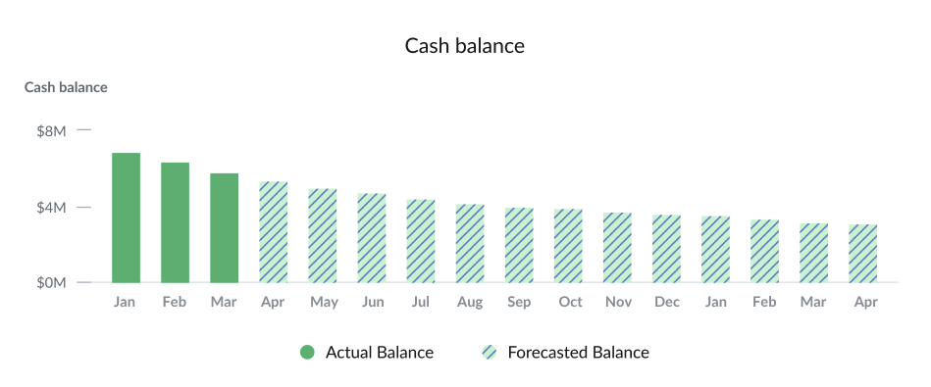
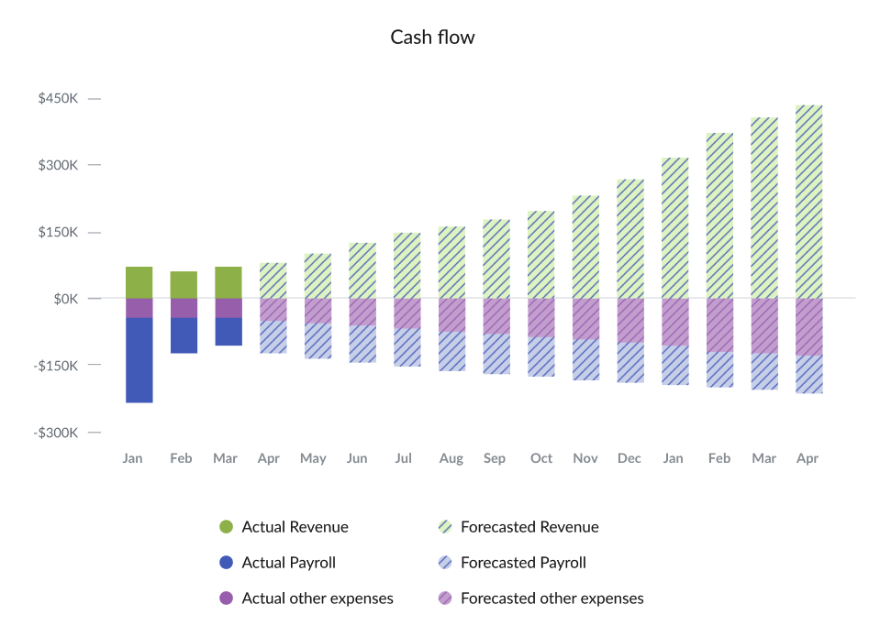
2025-2026 Forecast
2 minutes
Joe Lonsdale
"Be clear with how much runway you have left based on a few different revenue and cash burn assumptions. These aren't just bad/good/great projections. There should be detailed thought behind each assumption that you can speak to if necessary."
As of ____, cash in bank is $___. Over the next ___ months (April 2025 - April 2026) net burn will go from ___ to ___ with an increase of ___%. Revenue from April 2025 to April 2026 will increase from ___ to ___, with a growth rate of ___.

Slide 7
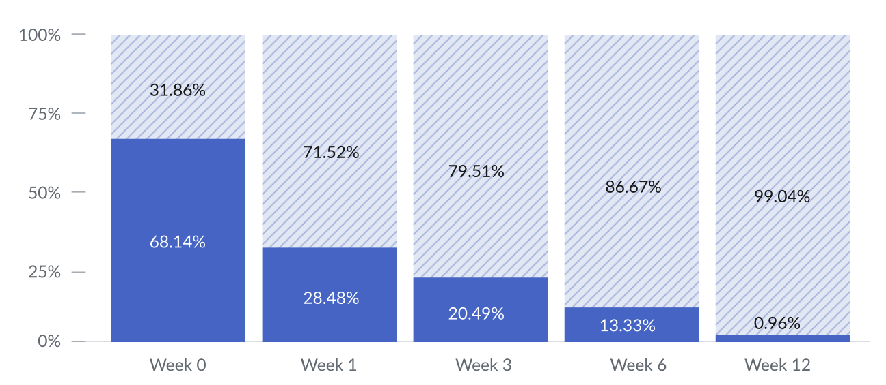
Q1 2025 Engagement Metrics
3 minutes
Joe Lonsdale
“Metrics on engagement are very important before companies find product market fit. Plan to align with your board early and have frequent conversations about this. Your North Star metric very well might be unique to your company. While standard metrics can apply, don't assume that they alone determine what matters most to your product.”
Retention of New Users
Growth in MAU’s

Slide 8
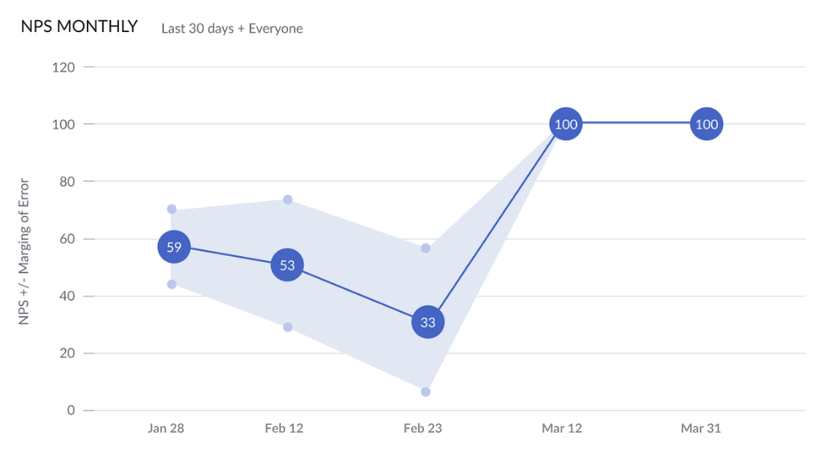
Q1 2025 Product Metrics
3 minutes

Slide 9
Product roadmap
5 minutes
Joe Lonsdale
“Product roadmaps need to be succinct. Grouping by phases helps board members quickly understand progress and see the whole picture.”
Phase one - (complete) -
Phase two - (starting now) -
Phase three (2026+) -
Phase four (TBD) -

Slide 10
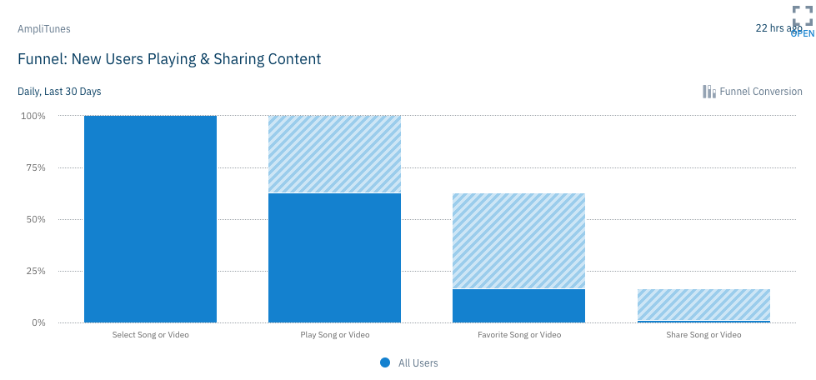
Sales Metrics
2.5 minutes
Joe Lonsdale
“Detailed sales metrics are my preference. Regularly review the marketing funnel, pipeline generation, conversion rates, and weighted pipeline. Call out surprising variances (both good and bad) and discuss what's driving these swings.”
Commentary on sales metrics
Comment 1
Comment 2
 | Q1 2024 | Q4 2024 | Q1 2025A | Q1 2025E | % Var
GTV | $10,000 | $800,000 | $1,750,000 | $1,500,000 | 17%
Average GTV/MAU | $200 | $400 | $350 | $400 | -13%
Take Rate | 0.30% | 0.50% | 0.70% | 0.50% | 0.20%
Transaction Revenue | $30 | $4,000 | $12,250 | $7,500 | 63%
SQLs | 20 | 1,100 | 3,150 | 3,000 | 5%
# Paid MAUs | 10 | 660 | 2,205 | 2,100 | 5%
% Paid MAUs | 20% | 33% | 44% | 42% | 2%
Avg. Sub Per Paid MAU | $10 | $8 | $8 | $8 | 0%
Subscription Revenue | $300 | $15,840 | $52,920 | $50,400 | 5%
Total Revenue | $330 | $19,840 | $65,170 | $57,900 | 13%

Slide 11
Marketing pipeline
2.5 minutes
Joe Lonsdale
“Remember, marketing is your high-level sales strategy or strategic view of the battlefield. Simple tables can't capture insights on what's working or missing on product and how those goals are interacting with your pipeline. As you grow, cohort analysis matters but even more important is to discuss and test your intuition on how marketing and product are interacting and what this means for your resource allocation and strategy."
Commentary on sales metrics
Comment 1
Comment 2
 | Q1 2024 | Q2 2024 | Q3 2024 | Q4 2024 | Q1 2025
Leads | 400 | 1,000 | 2,000 | 4,000 | 10,000
Users in Trial | 120 | 300 | 1,000 | 3,000 | 8,000
MAUs | 50 | 220 | 700 | 2,000 | 5,000
QoQ MAU |  | 340% | 218% | 186% | 150%
Conversion Rate | 13% | 22% | 35% | 50% | 50%

Slide 12
Open Strategy Questions
25 minutes
Joe Lonsdale
“Share multiple financial scenarios for the next three years, incorporating the resources and potential evolution of your business. Spend a lot of time on key strategic insights, core principles, product goals, and the market.”
5 Highest Priority Issues
Most Pressing Need
Existential Threats and Catalysts
Big Wins or Large Misses
Large Strategy Decisions
Key Hires

Slide 13
Where we could use your help
10 minutes
Joe Lonsdale
“Other than strategy, leverage your board members for help on key resources like talent, financing, business development, and leads from their network who are helpful to the business.”
Talent asks
Financing asks
Introductions and referrals

Slide 14
409A/Option Grants
5 minutes
Joe Lonsdale
“Remember to include fully diluted numbers and percentages for option grants.”

Slide 15
Appendix

