Slide 1
Board Meeting
Q1 2025
David Sacks
“For sales-driven companies, schedule your board meeting a couple weeks after the quarterly close, so the data is conclusive and fresh. You don’t want to be speculating about how the quarter is going to go. You want to know.”
April 16, 2025
Your company name

Slide 2
Agenda
David Sacks
“Board meetings should be 2-3 hours once a quarter. If your business is going through hard times, more frequent meetings may be necessary. In that case, add a 1 hour mid-quarter check-in.”
40
minutes
CEO Update
Company Overview
Strategic Learnings
KPIs
60
minutes
Departmental Updates
Sales
Product
Marketing
30
minutes
Financials
Team
10
minutes
Administrative Matters
20
minutes
Discussion

Slide 3
CEO Update
5 minutes
David Sacks
“This slide is your 30,000 foot strategic update. What’s going well, what’s not going well. What’s keeping you up at night.”
What’s Working
Recent or near term wins
New processes delivering better than expected
Milestones or company achievements
Product traction or positive media recognition
New major hires or team victories
What’s Not Working
Recurring processes that are broken
Issues that need solving
Recent negative development
Long term strategy or product concerns
Existential risks
Competitive threats

Slide 4
Strategic Learnings
5 minutes
David Sacks
“What have you learned about the market since the last board meeting?”
What’s the “diff” on the investor presentation (i.e. if you were to write your investor presentation today, what would be different)?
Initially believed A about market; now know B
Expected early adopters to be X, but turns out they are Y and Z
Forecasted growth at certain speed, realized that was too slow/too fast
Changes in the competitive landscape

Slide 5
5 minutes
David Sacks
“Don’t bury the lede here. It’s always good to know how much cash is in the bank and how much runway you have. Nothing worse than getting to the end of the meeting only to learn the business is out of runway and we should have been having a completely different conversation.”
Runway
CASH IN BANK
MONTHLY BURN
RUNWAY
$5,100,742
-$182K (Mar)
28 months
As of 03/31/2025
-$243K (Jan)
-$232K (Feb)
Mar 2025
MONTHLY BALANCE
$6M
$5.9M
$5.6M
$5.4M
$3.6M
$4M
$5.2M
$3M
$0M
Oct 2024
Nov 2024
Dec 2024
Jan 2025
Feb 2025
Mar 2025

Slide 6
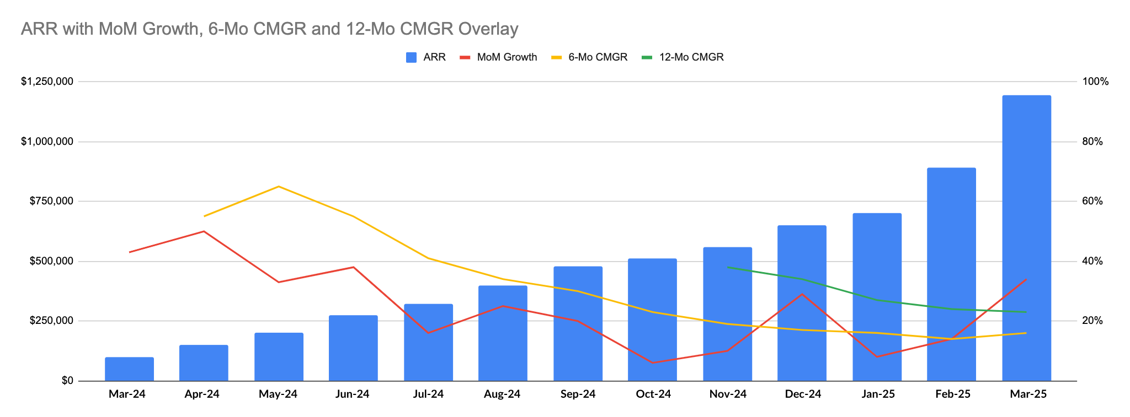
5 minutes
David Sacks
“Growth and runway are the two context setters. I like to understand how fast revenue is growing on a monthly basis. If you primarily sell annual contracts, you should use ARR as your key revenue metric. If you primarily sell monthly contracts, use MRR.”
Growth

Slide 7
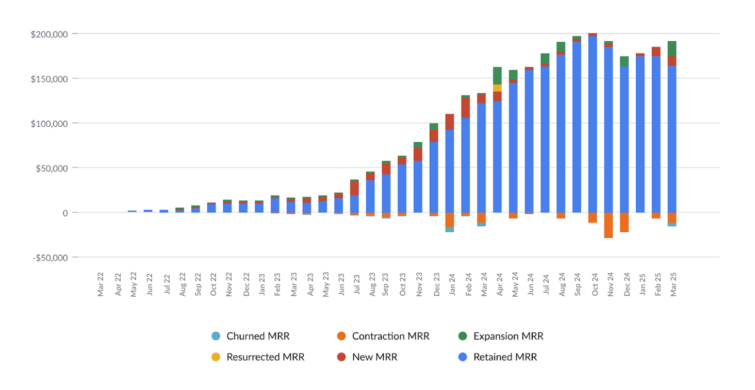
2.5 minutes
Detailed MRR

Slide 8
2.5 minutes
Cohorted Retention
 | Month 0 | Month 1 | Month 2 | Month 3 | Month 4 | Month 5 | Month 6 | Month 7 | Month 8 | Month 9 | Month 10 | Month 11 | Month 12
Mar 24 | 100% | 100% | 100% | 100% | 100% | 100% | 100% | 100% | 100% | 100% | 100% | 100% | 100%
Apr 24 | 100% | 99% | 96% | 93% | 109% | 109% | 101% | 107% | 107% | 107% | 107% | 108%
May 24 | 100% | 100% | 100% | 100% | 100% | 100% | 100% | 100% | 100% | 100% | 100%
Jun 24 | 100% | 100% | 100% | 100% | 100% | 64% | 64% | 64% | 64% | 64%
Jul 24 | 100% | 100% | 100% | 100% | 100% | 100% | 100% | 100% | 93%
Aug 24 | 100% | 100% | 100% | 100% | 100% | 100% | 100% | 100%
Sep 24 | 100% | 99% | 99% | 99% | 99% | 99% | 99%
Oct 24 | 100% | 56% | 56% | 56% | 56% | 56%
Nov 24 | 100% | 235% | 275% | 183% | 103%
Dec 24 | 100% | 100% | 100% | 83%
Jan 25 | 100% | 64% | 37%
Feb 25 | 100% | 13%
Mar 25 | 100%
Avg $ Retention | 100% | 92% | 91% | 89% | 89% | 88% | 88% | 88% | 88% | 88% | 89% | 88% | 86%

Slide 9
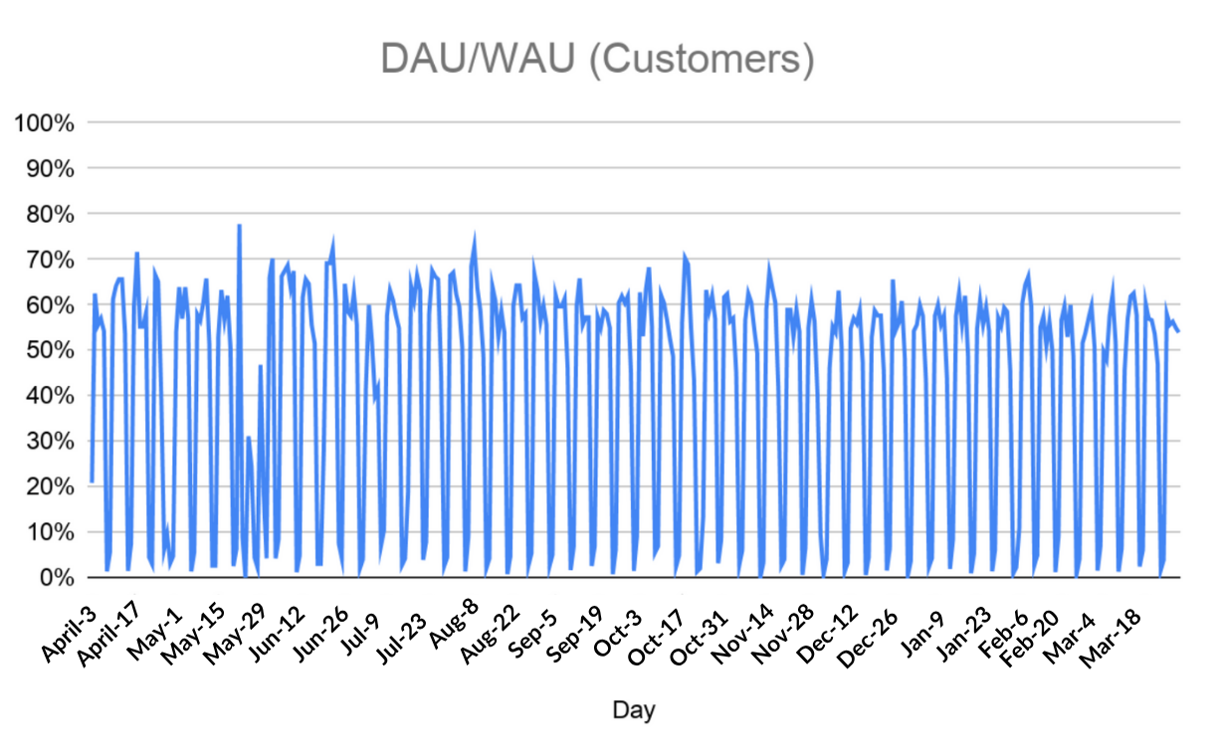
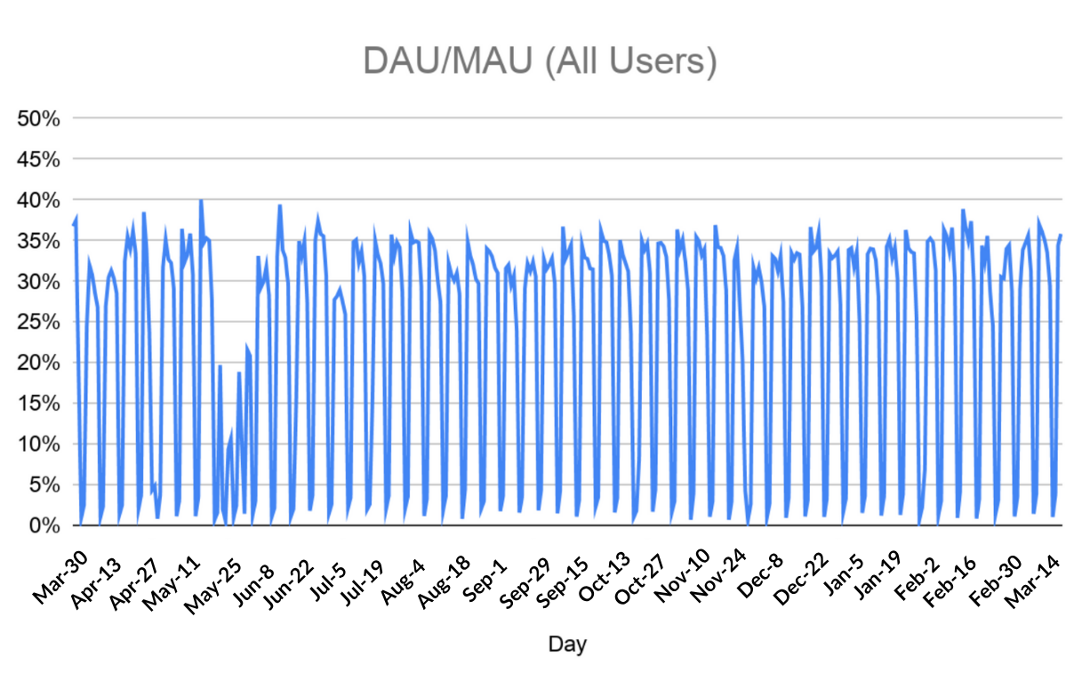
Engagement
10 minutes
David Sacks
Top 10 Customers
 | Users | DAU/MAU | DAU/WAU
Customer 1 | 240 | 38% | 72%
Customer 2 | 190 | 39% | 67%
Customer 3 | 180 | 36% | 69%
Customer 4 | 180 | 31% | 55%
Customer 5 | 135 | 30% | 63%
Customer 6 | 130 | 27% | 86%
Customer 7 | 125 | 28% | 71%
Customer 8 | 120 | 42% | 60%
Customer 9 | 100 | 20% | 100%
Customer 10 | 90 | 17% | 67%
“The simplest metrics for engagement are DAU/WAU and DAU/MAU. Look at the crests to understand workday usage. It’s also helpful to see engagement for your top 10 customers.”

Slide 10
Summary KPIs
5 minutes
David Sacks
 | Q1 2019 | Q2 2019 | Q3 2019 | Q4 2019 | Q1 2020
New Business ARR | 90,000 | 140,000 | 160,000 | 180,000 | 250,000
Expansion ARR | 30,000 | 50,000 | 50,000 | 60,000 | 85,000
Churn ($) | 10,000 | 0 | 10,000 | 20,000 | 20,000
Net New ARR | 110,000 | 190,000 | 200,000 | 220,000 | 320,000
Total ARR | 1,110,000 | 1,300,000 | 1,500,000 | 1,720,000 | 2,355,000
Burn | 330,000 | 410,000 | 440,000 | 505,000 | 580,000
Burn Multiple | 3.0X | 2.2X | 2.2X | 2.3X | 1.8X
ACV | $600 | $700 | $730 | $750 | $833
CAC | $1,667 | $1,600 | $1,400 | $1,300 | $1,150
Payback (Months) | 6.0 | 5.0 | 4.0 | 3.5 | 2.5
Net Dollar Retention | 154% | 145% | 145% | 130% | 137%
Logo Retention | 88% | 95% | 95% | 91% | 90%
“KPIs naturally link with the overview of the health of the business. I like burn multiple, similar to CAC, to discuss efficiency of growth. Alongside that, I like the SaaS KPIs listed above to understand performance and scale of the business.”

Slide 11
Sales Update

Slide 12
KPIs: Past Quarter
10 minutes
David Sacks
Q1 2025 Closed Deals
Account | Type | Status | New ARR Booked
Alpha | New | W | 80,000
Bravo | New | W | 70,000
Charlie | New | W | 100,000
Delta | New | L
Echo | Expansion | W | 10,000
Foxtrot | Expansion | W | 20,000
Golf | Expansion | L
Hotel | Renewal | W | 60,000
India | Renewal | W | 50,000
Juliet | Renewal | L
Kilo | Contraction | L | -10,000
Lima | Contraction | L | -10,000
Papa | Churn | L | -20,000
Last quarters’ new ARR by deals and contract size
New business vs. renewals
Expansion vs. contraction
Won vs. lost
“Many of the KPIs tether off of sales, so next up review closed deals and pipeline for the upcoming quarter. Include color on deals both won and lost: what was the deciding factor, what was the friction, and what objections/features were missing?”

Slide 13
KPIs: Pipeline
10 minutes
Pipeline Metrics:
Weighted pipe size: $ amount * probability dependent on stage
Weighted Total Pipeline for the upcoming quarter
Dive in on top accounts/targets
Account | Stage | Amount | Probability | Weighted Amount | Close Date
Alpha | Lead | $100,000 | 20% | $10,000 | Aug 25
Bravo | Lead | $50,000 | 20% | $7,500 | Jul 25
Charlie | Lead | $75,000 | 20% | $18,750 | Jul 25
Delta | Lead | $150,000 | 20% | $37,500 | Jul 25
Echo | Qualification | $200,000 | 40% | $80,000 | Jun 25
Foxtrot | Qualification | $75,000 | 40% | $30,000 | Jun 25
Golf | Qualification | $150,000 | 40% | $60,000 | May 25
Hotel | Demo | $75,000 | 60% | $45,000 | May 25
India | Demo | $150,000 | 60% | $90,000 | May 25
Juliet | Negotiation | $200,000 | 80% | $160,000 | Apr 25
Kilo | Negotiation | $150,000 | 80% | $120,000 | Apr 25
Lima | Proposal | $120,000 | 90% | $108,000 | Apr 25
Total Weighted Sales Pipeline in Q2 |  | $1,120,000 |  | $693,000

Slide 14
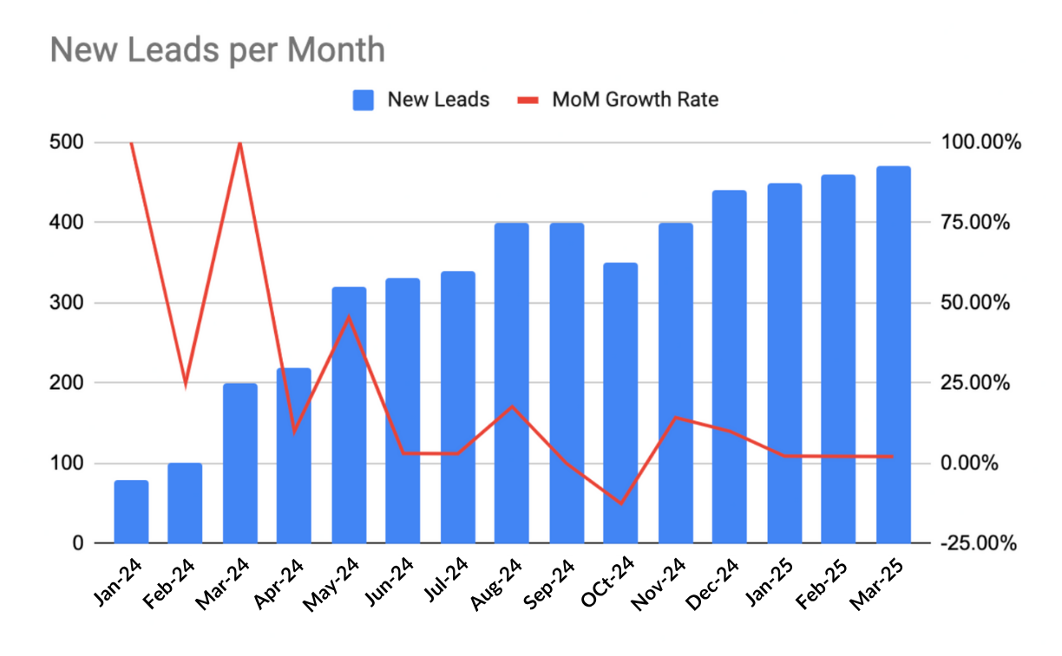
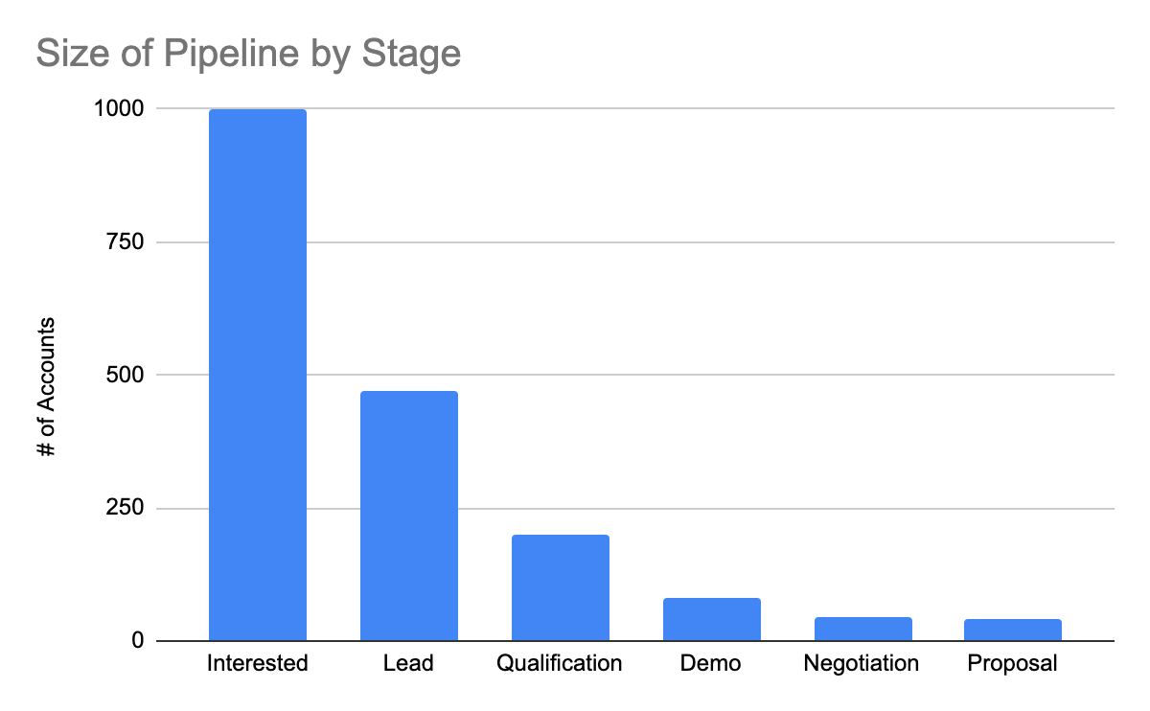
KPIs: Pipeline
10 minutes
Pipeline Overview
Stage | # of Accounts | QoQ Change % | Weighted Total Pipeline ($000s)
Interested | 1,000 | 25% | n/a
Lead | 470 | 30% | 400
Qualification | 200 | 40% | 600
Demo | 80 | 50% | 400
Negotiation | 45 | 60% | 300
Proposal | 40 | 40% | 250

Slide 15
Forecast: ARR
5 minutes
David Sacks
“I’m a fan of using this waterfall chart to track topline forecast over time as compared to original plan. I like this tool because it incentivizes operators to reforecast accurately and often; I appreciate when founders do this because it is hard to track what has changed over the course of the year. This keeps everyone on the same page. ”
 |  | Jan-25 | Feb-25 | Mar-25 | Apr-25 | May-25 | Jun-25 | Jul-25 | Aug-25 | Sep-25 | Oct-25 | Nov-25 | Dec-25
Original Plan |  | 700 | 880 | 1,200 | 1,350 | 1,550 | 1720 | 1,800 | 1,980 | 2,100 | 2,250 | 2,450 | 2,660
New Forecast | Jan-25 | 700 | 880 | 1,200 | 1,350 | 1,550 | 1,720 | 1,800 | 1,980 | 2,100 | 2,250 | 2,450 | 2,660
 | Feb-25 |  | 890 | 1,200 | 1,350 | 1,600 | 1,750 | 1,800 | 1,980 | 2,100 | 2,250 | 2,450 | 2,660
 | Mar-25 |  |  | 1,195 | 1,350 | 1,600 | 1,700 | 1,780 | 1,980 | 2,100 | 2,250 | 2,450 | 2,660
 | Apr-25
 | May-25
 | Jun-25
 | Jul-25
 | Aug-25
 | Sep-25
 | Oct-25
 | Nov-25
 | Dec-25
 | =FORECAST
 | =BEAT ORIGINAL PLAN
 | =MISSED ORIGINAL PLAN

Slide 16
Sales Update
5 minutes
David Sacks
Sales Rep Performance
Sales Rep | Deals Closed | Bookings | New ARR | Bookings Quota | Quota Attained
Sales Rep 1 | 8 | $150,000 | $75,000 | $120,000 | 125%
Sales Rep 2 | 6 | $70,000 | $50,000 | $60,000 | 117%
Sales Rep 3 | 7 | $110,000 | $80,000 | $100,000 | 110%
Sales Rep 4 | 9 | $85,000 | $50,000 | $80,000 | 106%
Sales Rep 5 | 4 | $100,000 | $50,000 | $100,000 | 100%
Sales Rep 6 | 3 | $180,000 | $90,000 | $200,000 | 90%
Sales Rep 7 | 3 | $40,000 | $40,000 | $50,000 | 80%
Sales Rep 8 | 2 | $35,000 | $30,000 | $50,000 | 70%
Sales Rep 9 | 2 | $60,000 | $55,000 | $100,000 | 60%
Sales Rep 10 | 2 | $75,000 | $65,000 | $150,000 | 50%
“ I like to review sales rep performance stack ranked by quota attainment. Here, discuss sales team needs and potential hiring plan. ”

Slide 17
Product Update

Slide 18
Product Update
10 minutes
David Sacks
Product Priorities
Releases: what we’ve done
Roadmap: what we plan to do
“For board meetings, focus on the major product priorities. You should be able to describe them with a list of bullets on 1 page. Nice to have: mockups of new products.”

Slide 19
Marketing Update (Optional)

Slide 20
Marketing Update
10 minutes
David Sacks
Share major news
Review of launch events
Results of major campaigns
New initiatives
Areas for improvement
“If you just did a major launch event, tell us how it went. What was the reaction to the product? What are major stakeholders saying?”

Slide 21
Financials
15 minutes
David Sacks
“After walking through the key departments and team, drop into the financials: what is the status and scale of the business. Here is where you can discuss fundraising plans and major financial items i.e. a focus on improving gross margin.”
Actual and Projected KPIs, Financials, and Fundraising Expectations
($000s) | 2023A | Q1 2024A | Q2 2024A | Q3 2024A | Q4 2024A | 2024A | Q1 2025A | Q2 2025E | Q3 2025E | Q4 2025E | 2025E | 2026E
Net New ARR | 0 | 40 | 175 | 205 | 240 | 240 | 955 | 305 | 400 | 450 | 1,630 | 4,650
ARR | 60 | 100 | 275 | 480 | 720 | 720 | 1,195 | 1,500 | 1,900 | 2,350 | 2,350 | 7,000
Revenue | 25 | 60 | 140 | 180 | 220 | 600 | $300 | 400 | 520 | 650 | $1,870 | 5,610
Gross Margin | -10% | -15% | -25% | -10% | 5% | -9% | 35% | 45% | 50% | 55% | 48% | 55%
Operating Expenses
R&D | 220 | 330 | 495 | 595 | 485 | 1,905 | 550 | 500 | 500 | 500 | 2,050 | 2,700
S&M | 100 | 150 | 225 | 330 | 495 | 1,200 | 450 | 500 | 550 | 600 | 2,100 | 4,000
G&A | 100 | 150 | 140 | 160 | 200 | 650 | 225 | 220 | 240 | 250 | 935 | 1,000
Total OpEx | 420 | 630 | 860 | 1,085 | 1,180 | 3,755 | 1,225 | 1,220 | 1,290 | 1,350 | 5,085 | 7,700
Operating Income | -423 | -639 | -895 | -1,103 | -1,169 | -3,806 | -1,120 | -1,040 | -1,030 | -993 | -4,183 | -4,615
Net Income | -428 | -639 | -895 | -1,103 | -1,169 | -3,811 | -1,125 | -1,045 | -1,035 | -998 | -4,188 | -4,620
Cash | 3,000 | 2,300 | 1,550 | 200 | 5,500 | 5,500 | 4,100 | 2,900 | 1,900 | 1,150 | 1,150 | 13,150
Debt | 0 | 0 | 250 | 500 | 500 | 500 | 500 | 500 | 500 | 750 | 1,000
Burn | -1,200 | -700 | -1,000 | -1,600 | -1,700 | -5,000 | -1,400 | -1,200 | -1,000 | -1,000 | -4,600 | -8,000
Capital Raise
Debt | 0 | 0 | 250 | 250 | 0 | 0 | 0 | 0 | 0 | 250 | 250 | 0
Equity | 0 | 0 | 0 | 0 | 7,000 | 7,000 | 0 | 0 | 0 | 0 | 0 | 20,000

Slide 22
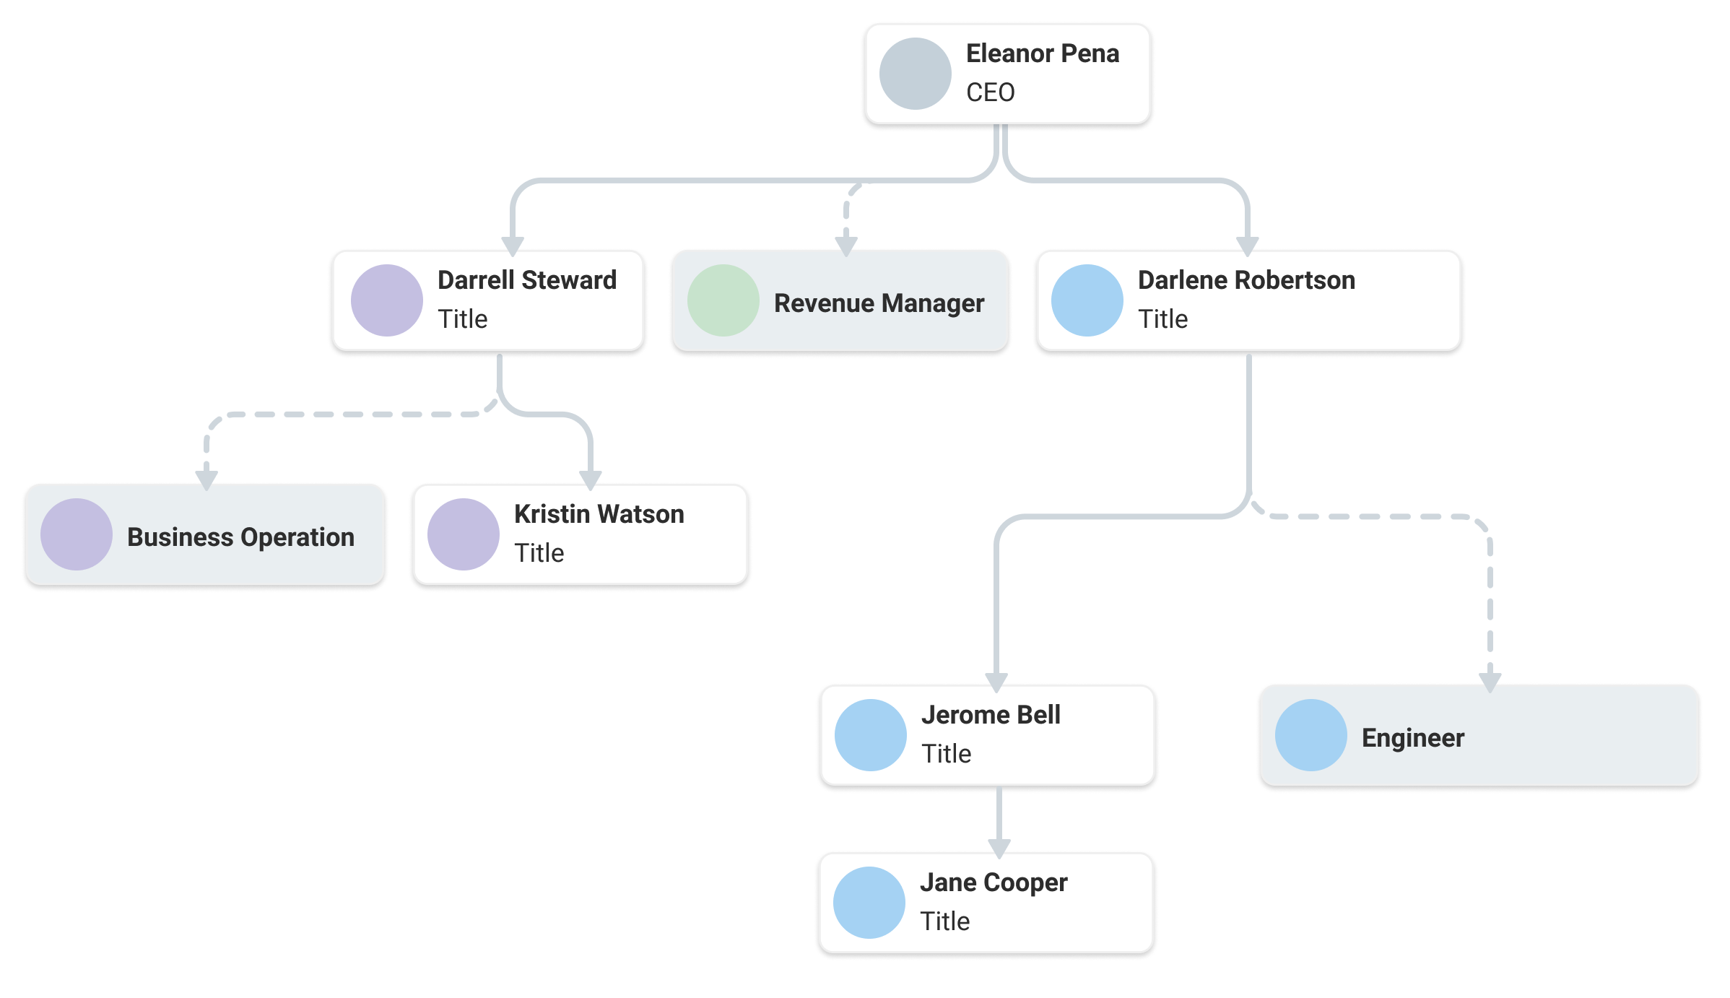
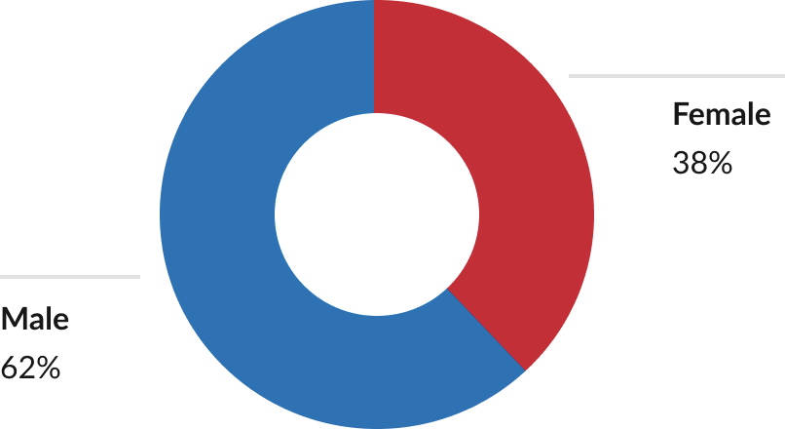
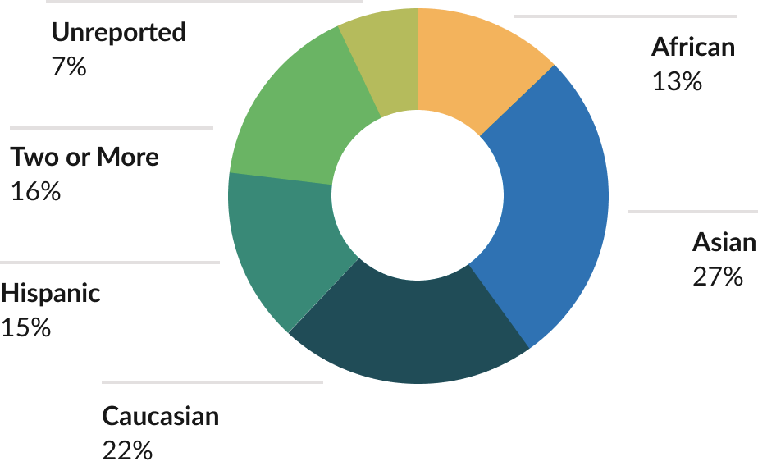
Team
15 minutes
David Sacks
Current Team headcount
Hiring plans and recruiting needs
Where we need the most help
“What does your ideal org chart look like compared to the one you have today? What are the areas that are on fire and have the greatest need for new hires?”

Slide 23
Administrative Matters [Closed Session]
10 minutes
David Sacks
“Handle administrative matters in closed session. Save for the end to avoid wasting time at the beginning of the meeting. Some of this can just be done by docusign.”
Proposed Option Grant
Employee | Start Date | Option Grant | % Gross | % Fully Diluted
Employee 1 | 1/1/2025 | 200,000 | 1% | 0.20%
Employee 2 | New Grant | 500,000 | 3% | 0.50%
Option Pool Data
 | Shares | % Gross | % Fully Diluted
Total Pool Size | 20,000,000 | 100.00% | 20.00%
Options Previously Issued | 10,000,000 | 50.00% | 10.00%
Options Proposed Today | 1,200,000 | 6.00% | 1.20%
Remaining Unissued | 8,800,000 | 44.00% | 8.8%

Slide 24
Discussion
20 minutes
David Sacks
“Open ended discussion of the most pressing needs of the business. ”

Slide 25
Appendix

